Slide 1
EMG510 Signature Assignment
‘Open Sesame’
Poorvaj Ravichandran Venkatraman - 95828

Slide 2
Contents
Background
Mobile app
Firebase
Mobile app advantages
Mobile strategy
Development
Marketing
Mobile requirements
Mobile development
App demo

Slide 3
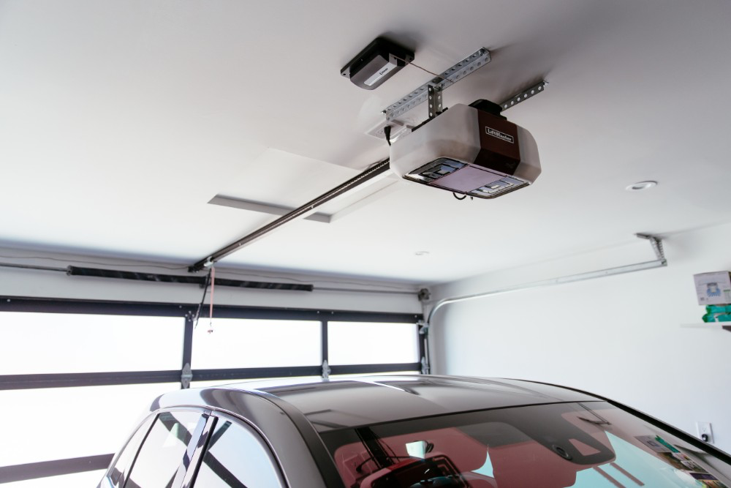

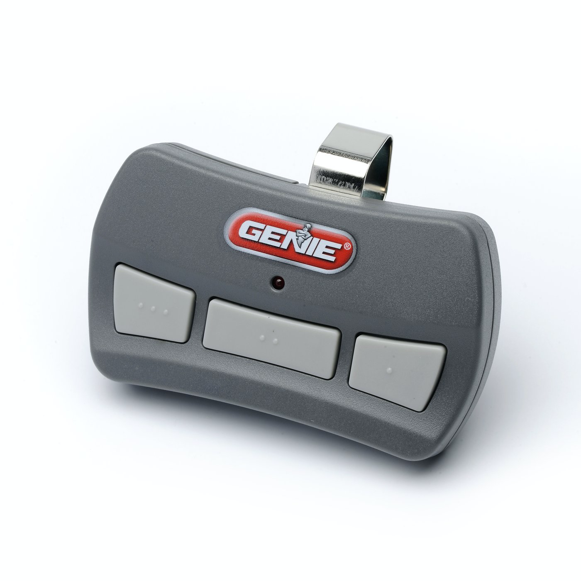
Background

Slide 4
Mobile App
Our signature assignment mobile app is a garage door opener that verifies:
User’s identity (i.e., user credentials)
Vehicles (i.e., license plate)
before transmitting a signal to wirelessly open the garage door. This app would replace a unsecure, traditional garage door remote. Current app is designed for a two-car garage.

Slide 5
Firebase
What is Firebase?
Suite of tools that help mobile and web app development and support
Pros
One platform with multiple tools that work together
Focus on building without worrying about infrastructure
Functionality
Analytics
Databases
Messaging
Crash reporting
ML
Hosting

Slide 6
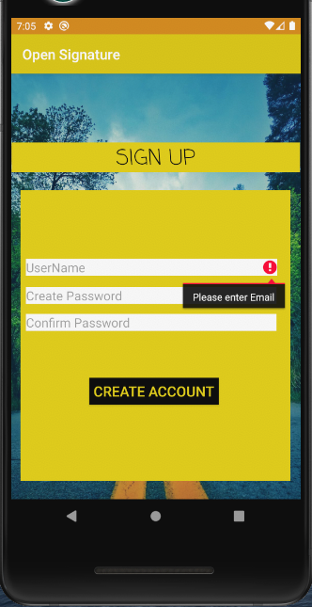
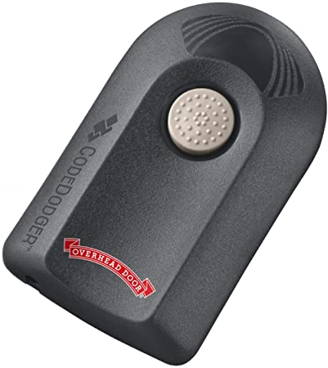
Mobile App Advantages
✘ Not secure
✘ No authentication
✘ No authorization
✘ Not device agnostic
✘ Not convenient
✘ No updates
✔ Secure
✔ Authentication
✔ Authorization
✔ Device agnostic
✔ Convenient
✔ Future updates

Slide 7
Development Strategy
Focus on UI and basic functionality first
User can download app from App Store / Play Store and use it seamlessly
App will authorize and authenticate users and vehicles
App will open garage door
First version will require user input
User will have to enter ID / vehicle info
Future iterations will include image processing and automation

Slide 8
Marketing Strategy
Go-to-market strategy
Test app with closed beta group
Iterate before releasing officially on App Store / Play Store
Work with garage door manufacturers
Market orientation
Occupants of buildings with garages
Homeowners
Tenants / renters
Current design accommodates max two cars

Slide 9
Mobile Requirements
App must allow user to enter username and password
App must allow user to enter vehicle data (i.e., license plate)
App must authorize user and vehicle (i.e., license plate)
App must authenticate user and vehicle
Backend / database must be able to store and edit user credentials and vehicle data
App must be able to communicate wirelessly with garage door opener
Garage door opener must be able to acknowledge and respond to app communication

Slide 10
Mobile Development
Android app written in Kotlin using Android Studio
Front end UI
Back end functions
Backend management done in Firebase
User access + management (sign-up, login)
User creation
Authentication
Authorization
Database management
App usage analytics
Crashlytics

Slide 11
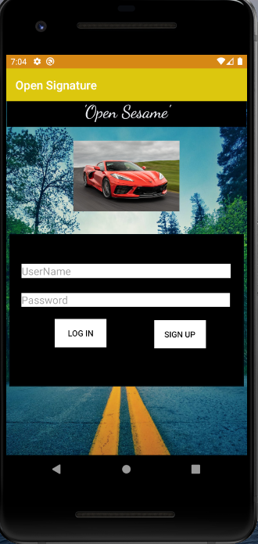
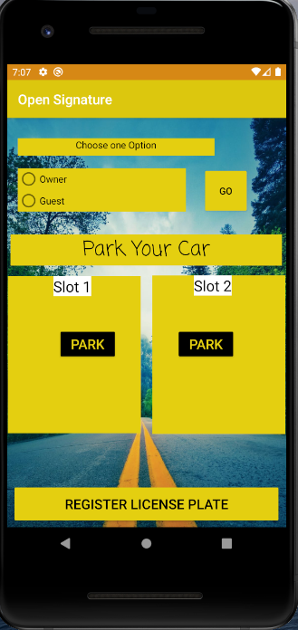
Demo

